Slide 1





01/17
Enterprise Network
DEPI
PROJECT

Slide 2




Enterprise Network
02/17
TEAM
MEMBERS
Ali Abdulqawi Ali
Mohamed Abdelaziz Eltawil
Fresh graduate from the Faculty of Computers and Information, IT Department. I have certification in CCNA, MCSA and CCNA.
Fresh graduate from the Faculty of Computers and Information, IT Department. I have certification in CCNA, MCSA and CCNA.
Mahmoud Ibrahim Kamal
Abdelrahman Moustafa Elsayed
A hardworking computer science and AI student with CCNA and CCNP certifications, I enjoy presenting on the latest tech developments and seek to join an innovative team focused on creating cutting-edge solutions.
Fresh graduate from the Faculty of Computers and Information, IT Department. I have certification in CCNA, MCSA and CCNA.
Supervisor Eng. Magdy Ibrahim

Slide 3

Enterprise Network
OUTLINE
03/17
1
4
7
10
PROJECT DESING
DHCP
STATIC & OSPF ROUTING
ACL
2
5
8
11
SSH
HSRP
WIRELESS
AAA
3
6
9
12
INTER-VLAN ROUTING
PORT SECURITY & BPDU GUARD
VLAN
GRE

Slide 4

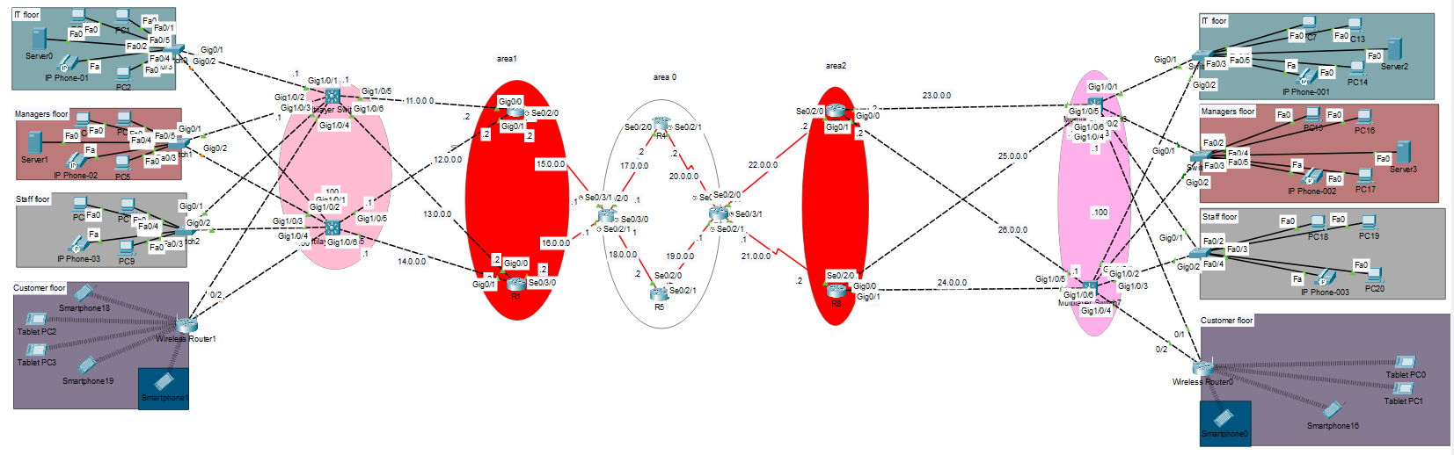
PROJECT
Enterprise Network
DESING
04/17

Slide 5
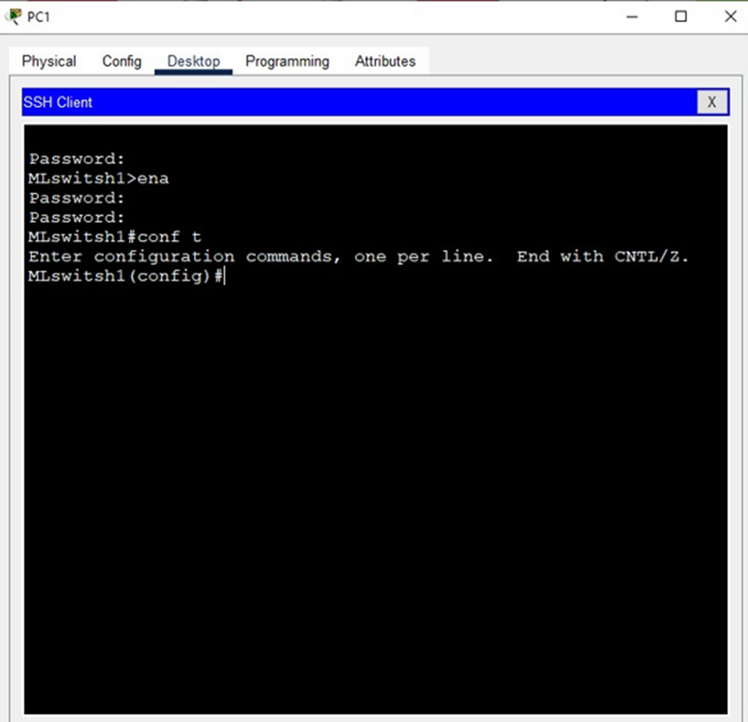
SSH
Enterprise Network
05/17
WE PRIORITIZED SECURITY BY IMPLEMENTING SSH ON OUR NETWORK ROUTERS AND SWITCHES. SSH ENCRYPTS DATA, MAKING IT A SAFER ALTERNATIVE TO TELNET. THIS PROTECTS CRUCIAL INFORMATION LIKE PASSWORDS AND CONFIGURATIONS FROM POTENTIAL CYBERATTACKS

Slide 6
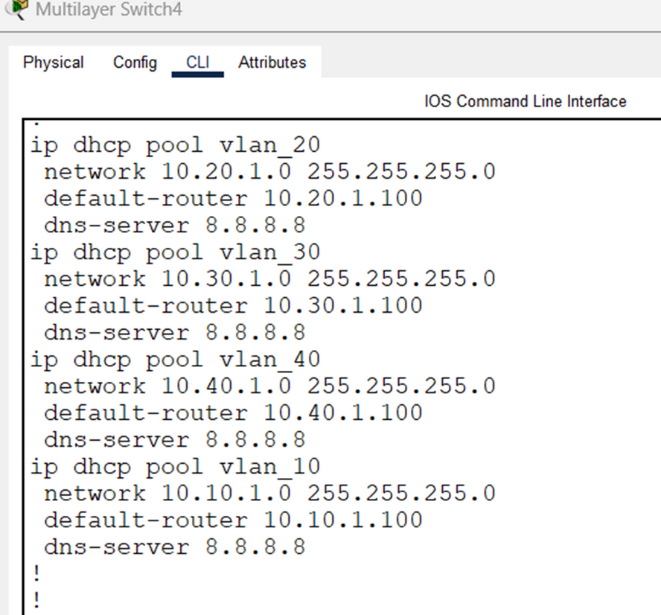
DHCP
Enterprise Network
06/17
TO ENSURE EFFICIENT IP ADDRESS MANAGEMENT, WE IMPLEMENTED DHCP ON OUR NETWORK. THIS AUTOMATED SYSTEM DYNAMICALLY ASSIGNS IP ADDRESSES, SUBNET MASKS, GATEWAYS, AND DNS SETTINGS TO DEVICES AS THEY CONNECT TO THE NETWORK. THIS ELIMINATES THE NEED FOR MANUAL CONFIGURATION, SAVING TIME AND PREVENTING IP ADDRESS CONFLICTS.

Slide 7
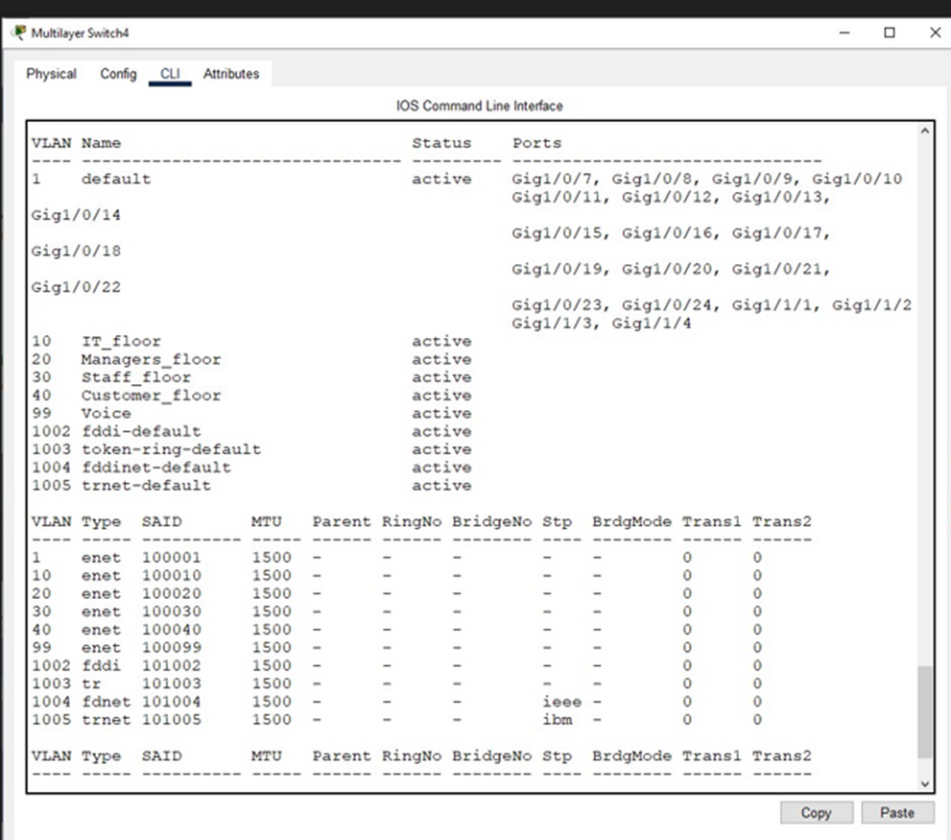
VLAN
Enterprise Network
07/17
WE IMPLEMENTED VLANS TO ENHANCE NETWORK SECURITY AND EFFICIENCY. BY SEGREGATING NETWORK TRAFFIC INTO DIFFERENT DEPARTMENTS (IT, MANAGEMENT, STAFF, AND CUSTOMER), WE IMPROVED PERFORMANCE AND MINIMIZED SECURITY RISKS. EACH VLAN HAD ITS OWN IP ADDRESS RANGE, FURTHER BOLSTERING SECURITY.

Slide 8
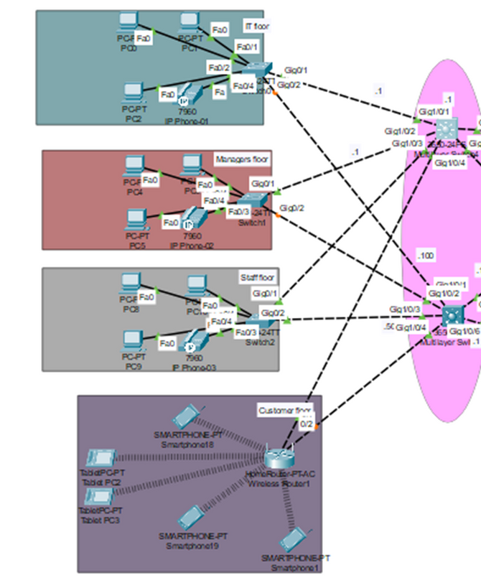
HSRP
Enterprise Network
08/17
TO ENSURE UNINTERRUPTED NETWORK SERVICES, WE IMPLEMENTED HSRP ON OUR ROUTERS. THIS REDUNDANCY PROTOCOL ALLOWS MULTIPLE ROUTERS TO WORK TOGETHER, WITH ONE ACTING AS THE PRIMARY AND THE OTHERS AS BACKUPS. IF THE PRIMARY ROUTER FAILS, A BACKUP AUTOMATICALLY TAKES OVER, ENSURING MINIMAL DOWNTIME AND CONTINUOUS NETWORK ACCESS.

Slide 9
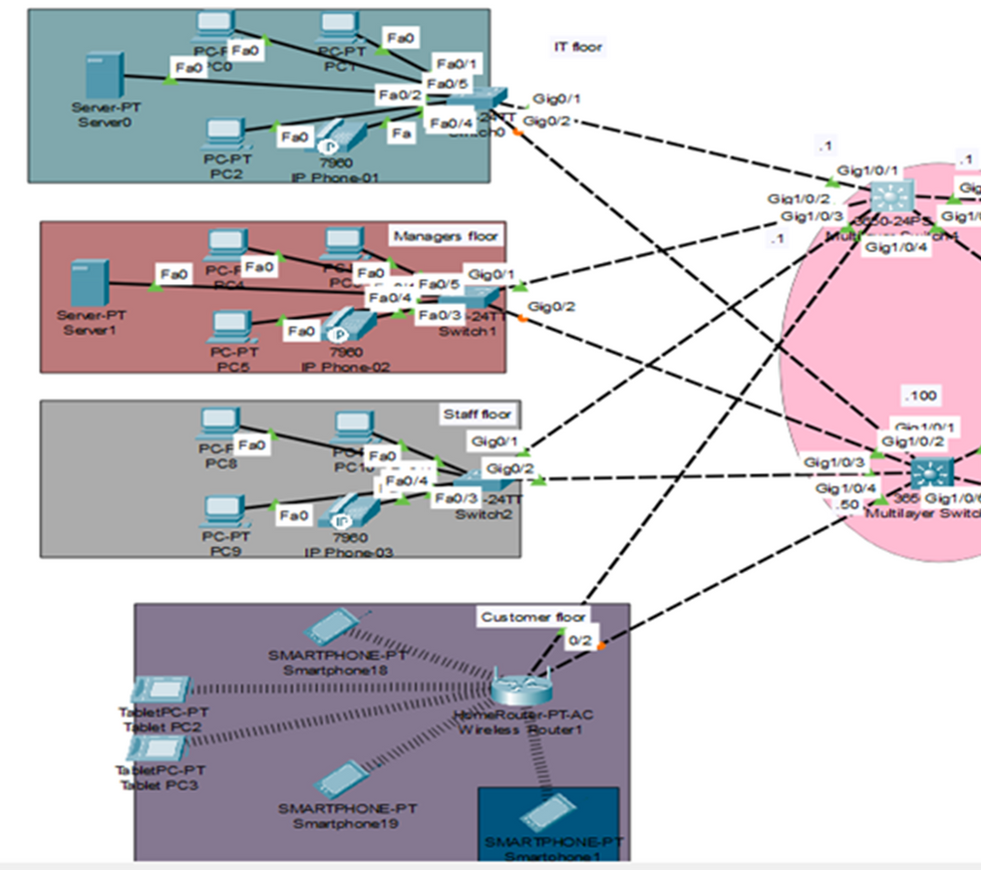
INTER-VLAN
Enterprise Network
09/17
TO ACHIEVE A MORE EFFICIENT AND FLEXIBLE NETWORK, WE CHOSE MLS AS THE BEST SOLUTION TO CONNECT VLANS IN OUR PROJECT. THIS TECHNOLOGY COMBINES THE ADVANTAGES OFFERED BY SWATCHES WITH TRADITIONAL TENSIONS, MAKING IT EASIER TO MANAGE AND EXPAND THE NETWORK.

Slide 10
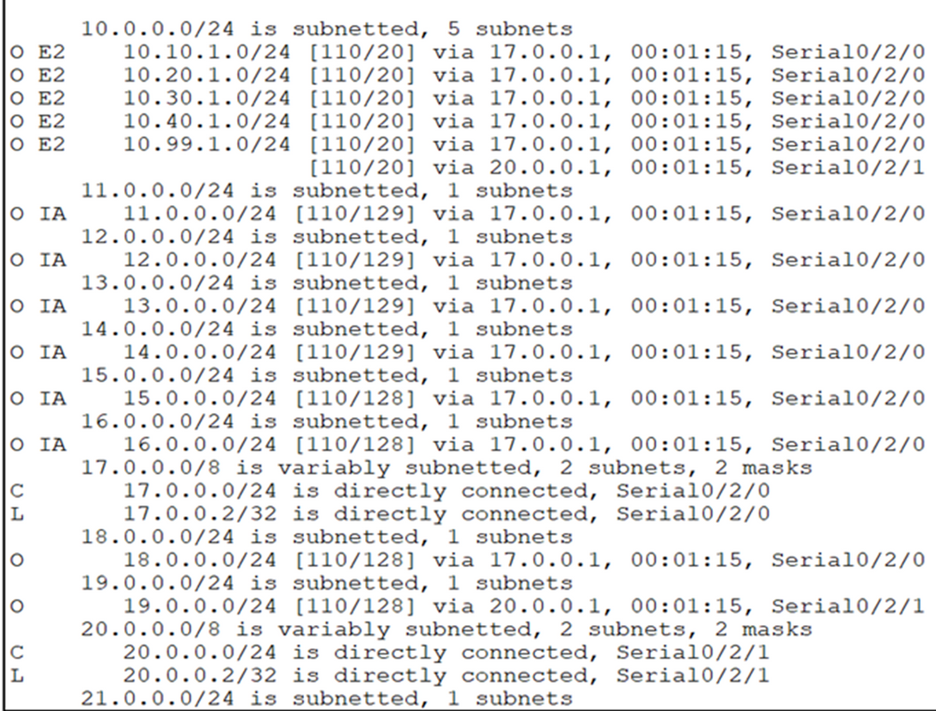
STATIC & OSPF ROUTING
Enterprise Network
10/17
IN OUR PROJECT, WE USED A HYBRID SOLUTION THAT COMBINES A MULTI-AREA OSPF PROTOCOL WITH STATIC ROUTING TO ACHIEVE GREATER NETWORK MANAGEMENT FLEXIBILITY. WE REDISTRIBUTED STATIC NETWORKS WITHIN OSPF REGIONS TO ENSURE SEAMLESS ACCESS BETWEEN DIFFERENT PARTS OF THE NETWORK

Slide 11
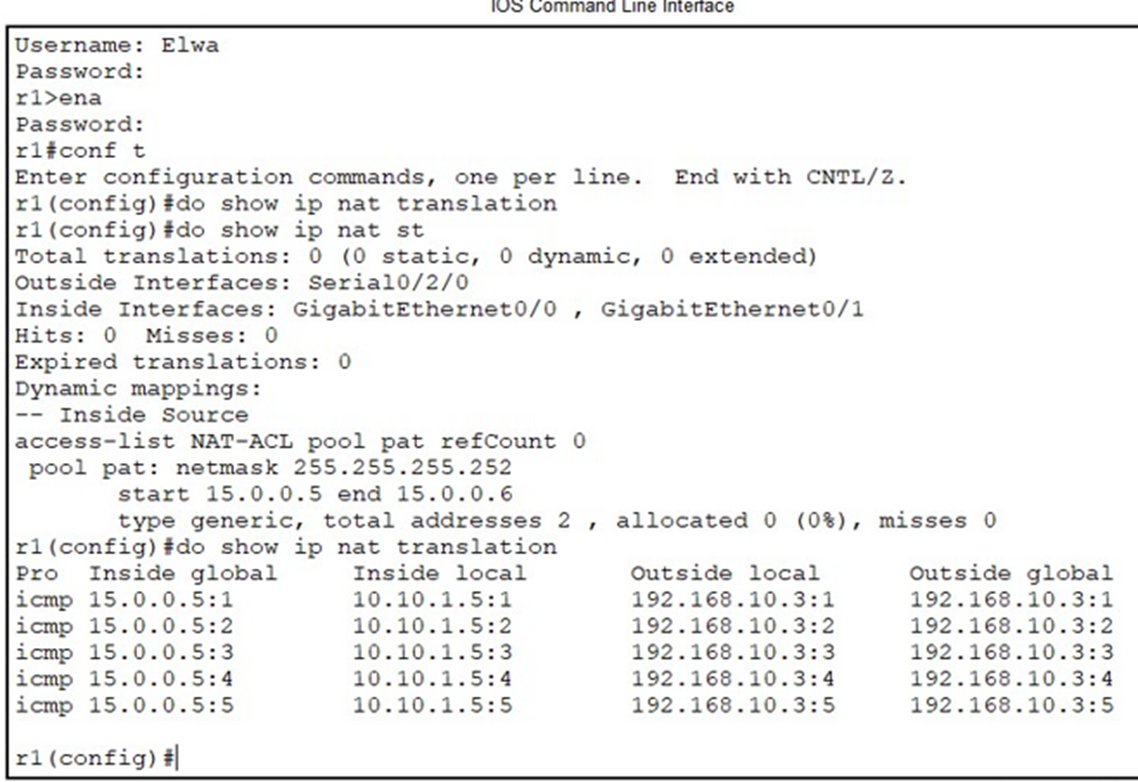
NAT
Enterprise Network
11/17
TO FACILITATE COMMUNICATION BETWEEN INTERNAL AND EXTERNAL NETWORKS, WE IMPLEMENTED NAT ON OUR CORE ROUTERS. THIS ENABLED MULTIPLE DEVICES TO SHARE A SINGLE PUBLIC IP ADDRESS FOR INTERNET ACCESS, CONSERVING IP ADDRESSES AND PROVIDING A LAYER OF SECURITY BY PREVENTING DIRECT EXTERNAL ACCESS TO INTERNAL DEVICES

Slide 12
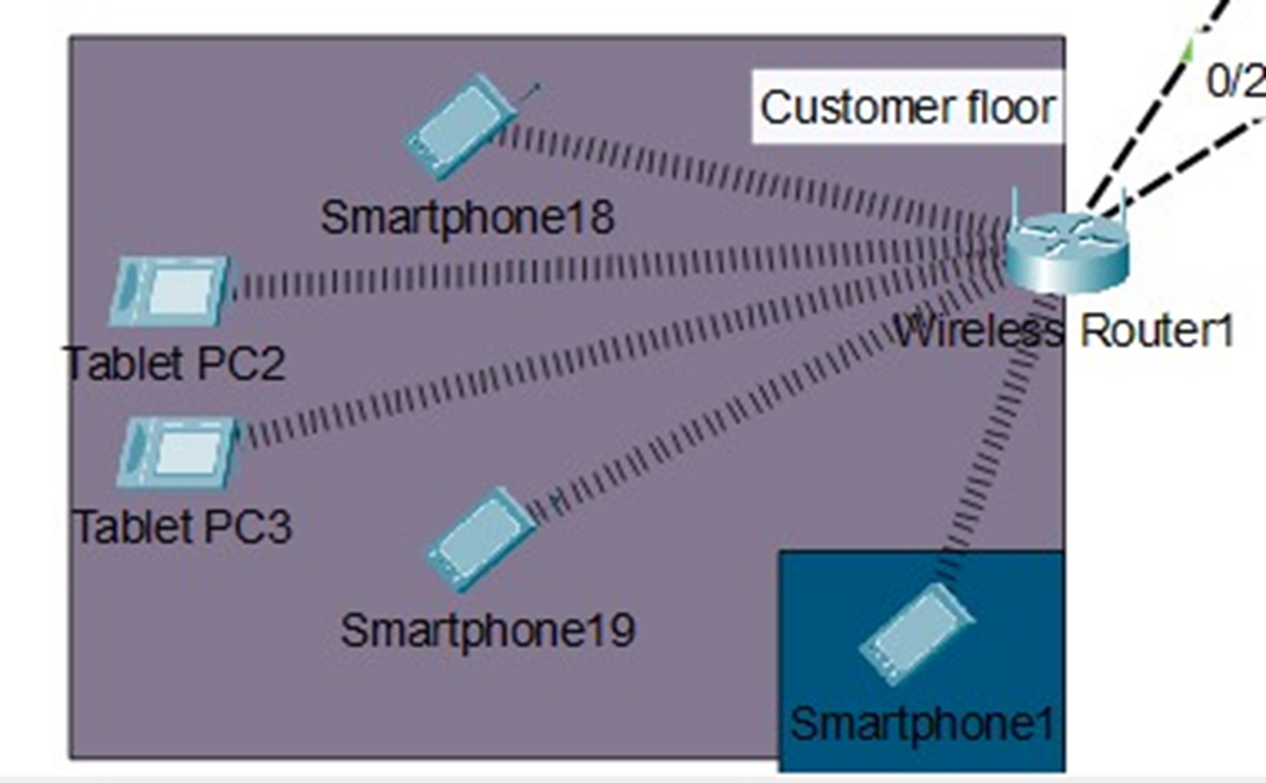
WIRELESS
Enterprise Network
12/17

Slide 13
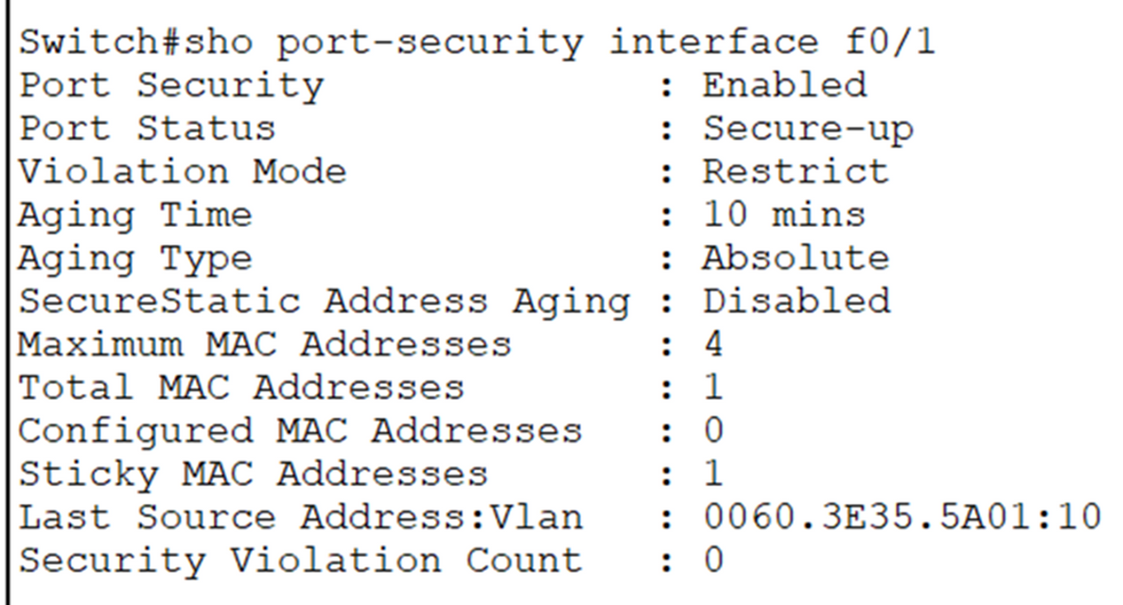
PORT SECURITY & BPDU GUARD
Enterprise Network
13/17
TO PROTECT AGAINST MAC ADDRESS TABLE ATTACKS, WE IMPLEMENTED PORT SECURITY ON ALL SWITCHES IN THE NETWORK.
AND ALSO TO PREVENT STP ATTACKS, WE ENABLED PORT FAST AND BPDU GUARD ON ALL SWITCHES. PORT FAST SPEEDS UP NETWORK CONVERGENCE, WHILE BPDU GUARD BLOCKS UNAUTHORIZED BPDUS.

Slide 14
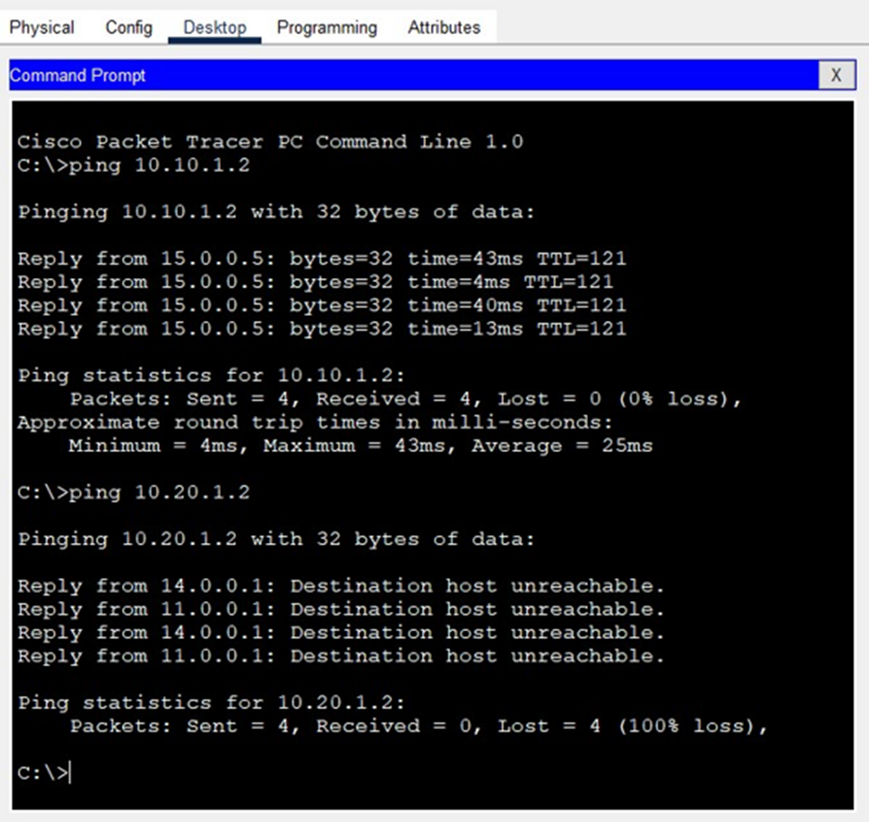
ACL
Enterprise Network
14/17
WE CONFIGURED ACLS TO REGULATE THE FLOW OF TRAFFIC,
allowing only authorized devices and users to access specific
parts of the network. ACLs provide a foundational layer of
security, preventing malicious traffic from entering critical
areas of the network, like the management or IT floors. With
precise ACL rules, we've minimized the risk of internal and
external threats

Slide 15
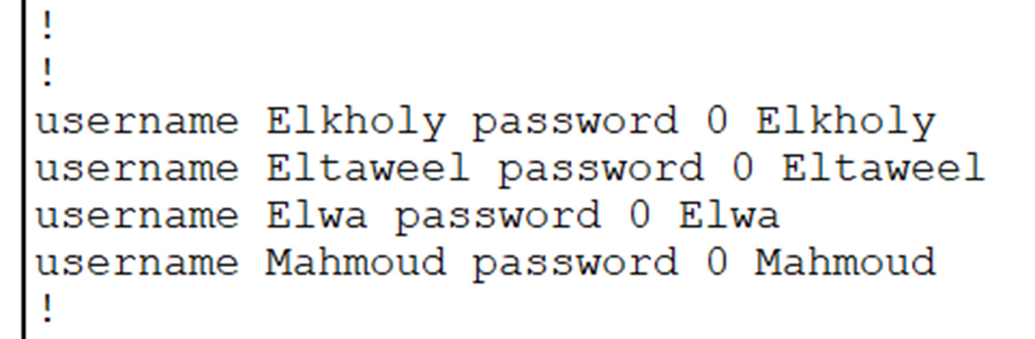
AAA
Enterprise Network
15/17
TO ENHANCE NETWORK SECURITY, WE IMPLEMENTED AN AAA FRAMEWORK. THIS FRAMEWORK MANAGES USER ACCESS BY VERIFYING THEIR IDENTITY, DEFINING THEIR PRIVILEGES, AND TRACKING THEIR NETWORK ACTIVITY. WE USE RADIUS TO SECURE NETWORK ACCESS, ENSURING ONLY AUTHORIZED USERS CAN ACCESS RESOURCES AND ALL ACTIVITIES ARE LOGGED FOR AUDITING

Slide 16
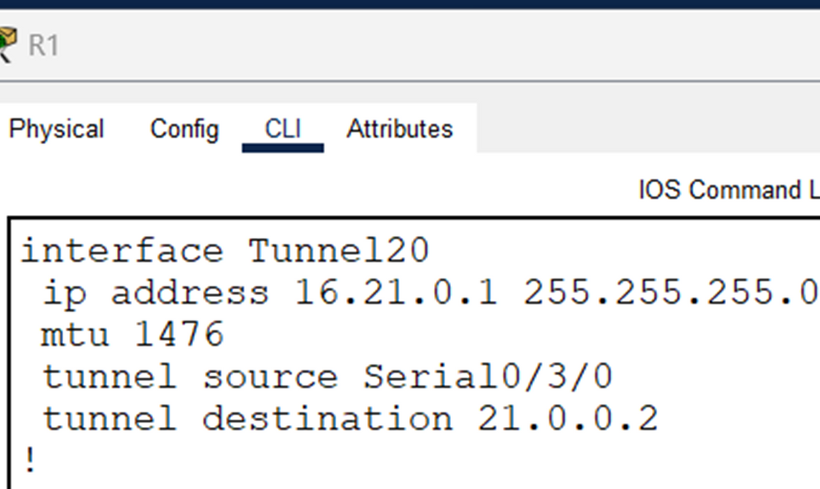
GRE
Enterprise Network
16/17
WE USED GRE AS A BASIC MECHANISM TO CREATE VIRTUAL PRIVATE NETWORK INFRASTRUCTURE, ALLOWING US TO CONNECT OUR REMOTE SITES RELIABLY AND AS A FUTURE STEP, WE PLAN TO DEVELOP A MORE COMPREHENSIVE VPN SOLUTION BY ENCRYPTING GRE TUN USING POWERFUL ENCRYPTION PROTOCOLS SUCH AS IPSEC

Slide 17
Enterprise Network
17/17
THANK
YOU!

